Slide 1

Crowd Simulation
PHILIPP LÜTOLF, SAMUEL OBERHOLZER
ZÜRICH, 14.05.2014

Slide 2
Contents
Introduction
Our Model
Implementation
Results and Discussion
Outlook/Improvements
Questions

Slide 3
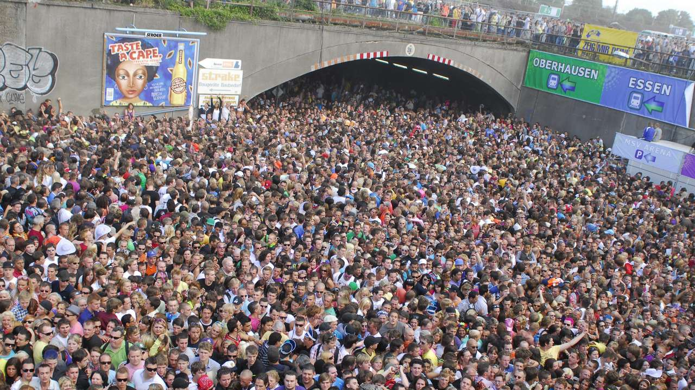
Introduction
Notes:
Events

Slide 4
Research Questions
Where are the most critical spots for people in a crowd in a given environment?
What are the possibilities to reduce the risk to individual people by rearranging the environment?

Slide 5
Our Model
The Social Force Model by Helbing
Agent-Based
Continuous Space

Slide 6
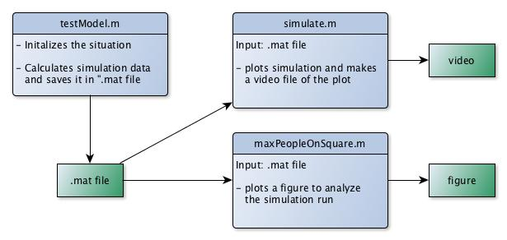
Implementation Overview

Slide 7
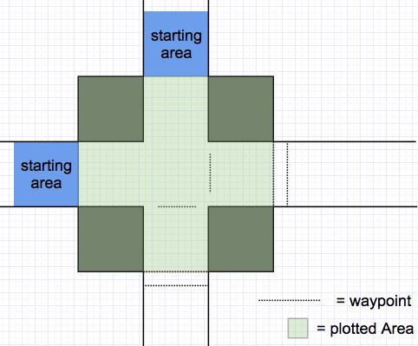
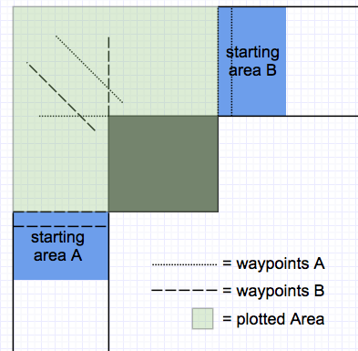
Testmodel.m - Initialization

Slide 8
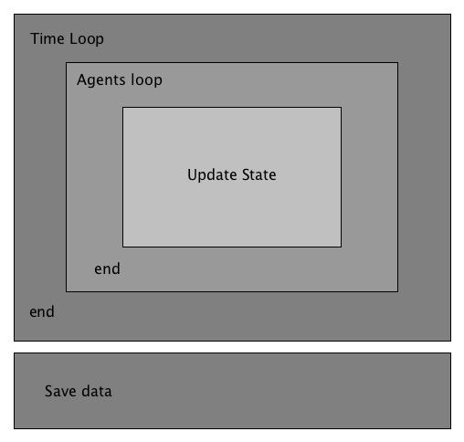
Testmodel.m - Computation
Time loop
  Processing each time step
Agents loop
  Processing each agent
Update
  Set next destination, calculate desired direction
  Compute the forces acting on the agent
  Update position
Save data
  Fur further analysis

Slide 9
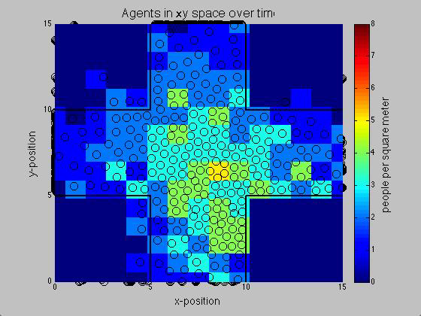
Simulate.m
Plot the simulation
Save video file

Slide 10
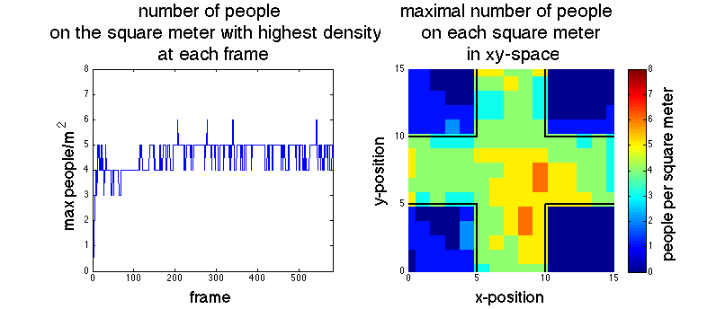
MaxPeopleOnSquare.m

Slide 11
Results
Number of pedestrians
  200 and 300 people
Time frame
  30 seconds
Obstacles
Situation
  curve and cross-situation

Slide 12
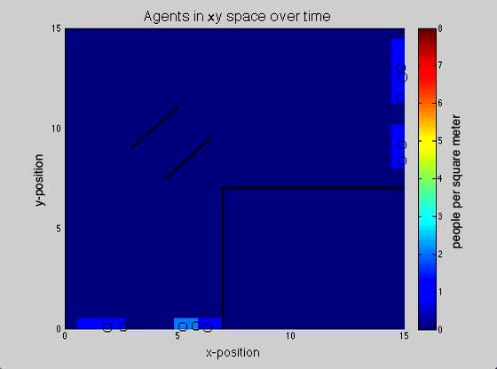
Curve-situation with 300 people and obstacles

Slide 13
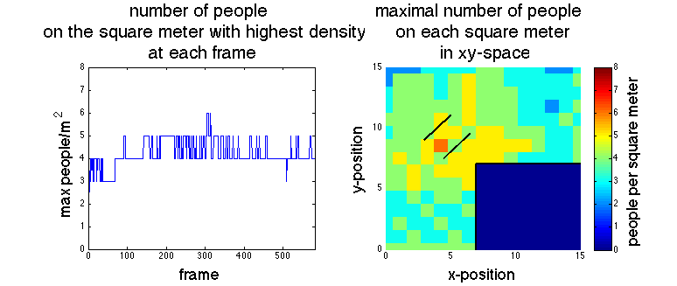
Curve-situation with 300 people and obstacles

Slide 14
Summary
Simulation sufficient to identify the critical spots in different locations
To find obstacles which reduce the risk on pedestrians, further investigation has to be done

Slide 15
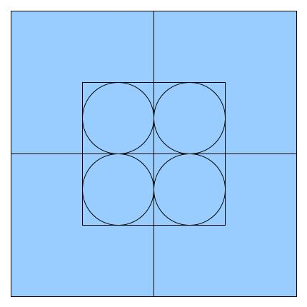
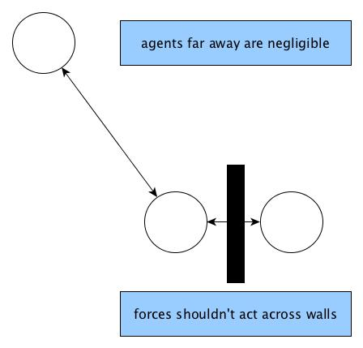
Improvements/outlook

Slide 16

Questions

